Slide 1

Infinibatch
Data loading library for massive data sets with built-in checkpointing support
Robert Gmyr
Frank Seide

Slide 2
“Any sufficiently complicated C or Fortran program contains an ad hoc, informally-specified, bug-ridden, slow implementation of half of Common Lisp.”
Greenspun's tenth rule
deep-learning data loader
Infinibatch
Seide’s

Slide 3
Data Loader Requirements
Randomized data loading
Support for corpora much larger than RAM, only load what is needed
Checkpointing – efficient and 100% accurate
Dynamic batching
Minimal data preparation
Multi-process pre-fetching
Compression
Flexible, extensible, modular, composable
No hard-coded assumptions about the data
aka Infinibatch
Notes:
Fast start-up time: Do not read entire corpus into RAM
Efficient checkpointing
Allow checkpointing to begin with!
Do not read through all previous data when resuming
Minimal data preparation: No index
Only load data that is needed: Distributed training
Composable architecture: Support complex data loading from multiple documents, multiple tasks, etc.

Slide 4
Agenda
Demo
Architecture and API
Checkpointing
Hierarchical Shuffling
Batching
Complex example: Multi-task training data loader
I want it! How do I get it?
Summary

Slide 5
Demo

Slide 6
Architecture and API
Data loaders are pipelines of nested iterators
Each iterator
reads items from a source iterator,
transforms what it reads, and
yields via the Python iterator interface
cf. Python itertools or C# LINQ
CheckpointableIterator interface
Python iterators: iter(), next()
getstate(), setstate()
17 iterator "primitives"
data loader is created by composing primitive iterators
user-specific knowledge via callbacks/lambdas
New iterators are often composed of existing ones
Infinite Permutation Iterator
Select Many Iterator
Blockwise Shuffle Iterator

Slide 7
Architecture and API
MapIterator
ZipIterator
WindowedIterator
RecurrentIterator
RandomIterator
SelectManyIterator
InfinitePermutationSourceIterator
BlockwiseShuffleIterator
BucketedReadaheadBatchIterator
PrefetchIterator
ChunkedSourceIterator
FixedBatchIterator
NativeCheckpointableIterator
MultiplexIterator
BufferedShuffleIterator
ParallelMapIterator
SamplingRandomMapIterator
Data loaders are pipelines of nested iterators
Each iterator
reads items from a source iterator,
transforms what it reads, and
yields via the Python iterator interface
cf. Python itertools or C# LINQ
CheckpointableIterator interface
Python iterators: iter(), next()
getstate(), setstate()
17 iterator "primitives"
data loader is created by composing primitive iterators
user-specific knowledge via callbacks/lambdas
New iterators are often composed of existing ones

Slide 8
Checkpointing
A "checkpoint" encodes current position in data set during iteration
If training crashes, allows to resume from last checkpoint
Training becomes completely reproduceable
Each iterator exposes getstate() and setstate()
cp = it.getstate()
recursively collects nested source iterator state(s)
returns a pickle-able dictionary (lighweight state only, no data)
it.setstate(cp)
"fast-forwards" to position encoded in cp
restores the iterator's own state
recursively restores nested source states
does not just re-fetch all data from start!
User code invokes these on top-level iterator only
Works automatically for custom pipelines

Slide 9
Hierarchical Shuffling
Chunk 1
Chunk 2
Chunk 3
Chunk 4
Chunk 5
Chunk 6
Chunk 7
Chunk 8
1. Level: Randomize Chunk References
Chunk 3
Chunk 7
Chunk 1
Chunk 2
Chunk 5
Chunk 4
Chunk 8
Chunk 6
2. Level: Shuffle data items from multiple chunks
Randomized Data

Slide 10
Hierarchical Shuffling
Chunk 1
Chunk 2
Chunk 3
Chunk 4
Chunk 5
Chunk 6
Chunk 7
Chunk 8
1. Level: Randomize Chunk References
Chunk 3
Chunk 7
Chunk 1
Chunk 2
Chunk 5
Chunk 4
Chunk 8
Chunk 6
2. Level: Shuffle data items from multiple chunks
Randomized Data
Low RAM usage, determined by window size
Minimal data preparation
Data sets can easily be combined
Caveat: Bias in choice of permutation of data
We have not observed adverse effects
GPU striding by subsetting chunk references
Caveat: no notion of epoch

Slide 11
Batching
Group sentences of similar length into minibatches
E.g. Marian-NMT [Marcin Junczys-Dowmunt et al.]:
read-ahead a “maxi-batch”
form batches by bucketing & padding
shuffle batches
BucketedReadaheadBatchIterator
Dynamic batching
Make best use of GPU resources with variable-length sentences
Adjust number of sentences w.r.t. sentence length
User callbacks to determine how many sentences of given lengths to group

Slide 12
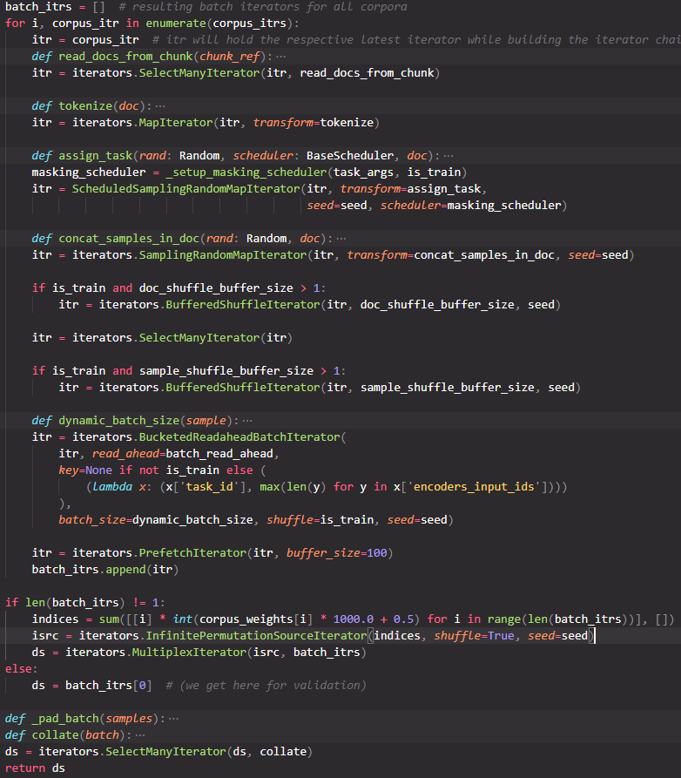
A Complex Example Data Loader Multitask Learning
Data Set 1
Data Set 2
Data Set n
InfPermIt
(Indices)
Prefetch
Prefetch
Prefetch
MultiplexIterator
SelectManyIterator (Pad and Collate)
Batches

Slide 13
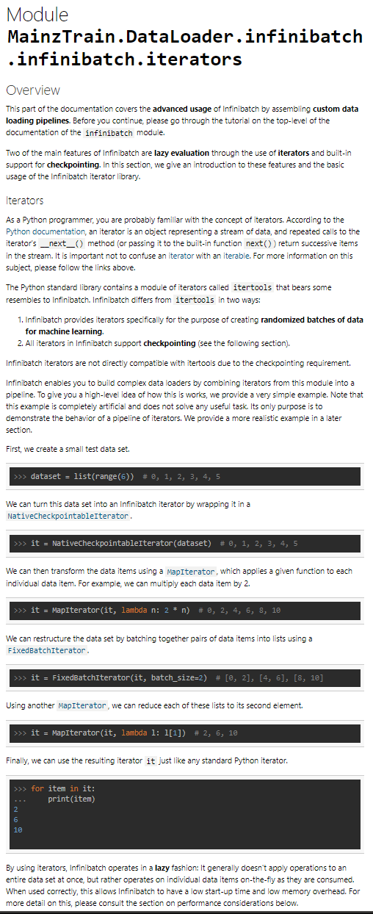
Ok, I want it! How do I get it?
GitHub: https://github.com/microsoft/infinibatch
Tutorial and doc on GitHub landing page

Slide 14
Summary
Infinibatch: Efficient, check-pointed data loading for deep learning with massive data sets
Randomized data loading via hierarchical shuffling
Only load what is needed → Support for corpora of any size
Checkpointing – efficient and 100% accurate
Batching made easy
Minimal data preparation
Multi-process pre-fetching
Compression
Flexible, extensible, modular, composable
No hard-coded assumptions about the data
Available at: https://github.com/microsoft/Infinibatch
Contact: Robert Gmyr, Frank Seide

